Slide 1


William Stallings Computer Organization and Architecture 8th Edition
Chapter 9
Cont. Computer Arithmetic
Book by : Computer, Architecture and Organizations, 8th Edition ,William Stalling
Original Slides by : Adrian J Pullin

Slide 2
Cont. Computer Arithmetic

Slide 3
Lecture Outcomes
Understanding of:
Multiplication
Unsigned Integer Multiplication
Booth’s Algorithm Multiplication

Slide 4
Multiplication
Complex
Work out partial product for each digit
Take care with place value (column)
Add partial products

Slide 5
Multiplication Example
1011 Multiplicand (11 dec)
x 1101 Multiplier (13 dec)
1011 Partial products
0000 Note: if multiplier bit is 1 copy
1011 multiplicand (place value)
1011 otherwise zero
10001111 Product (143 dec)
Note: need double length result

Slide 6
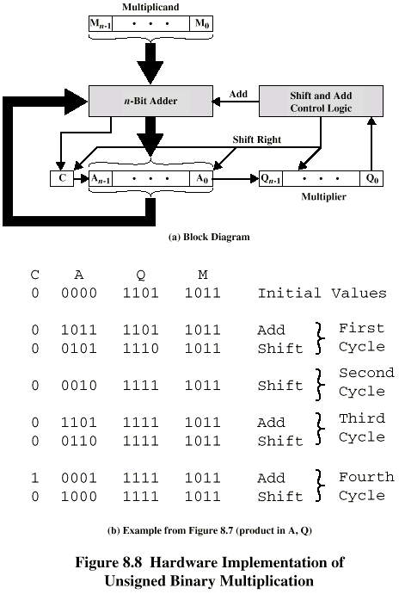
Unsigned Binary Multiplication

Slide 7
Execution of Example

Slide 8
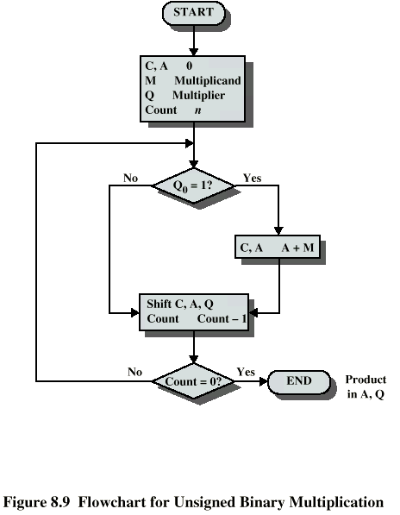
Flowchart for Unsigned Binary Multiplication

Slide 9
Multiplying Negative Numbers
This does not work!
Solution 1
Convert to positive if required
Multiply as above
If signs were different, negate answer
Solution 2
Booth’s algorithm

Slide 10
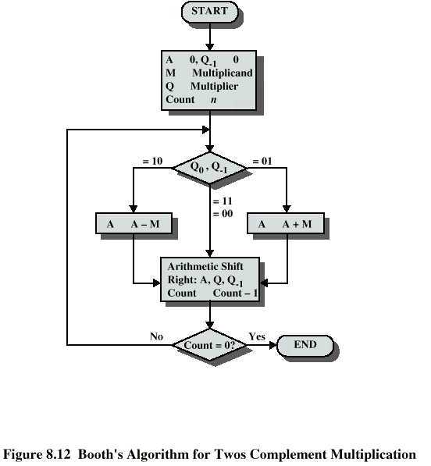
Booth’s Algorithm

Slide 11
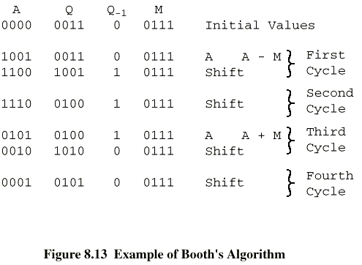
Example of Booth’s Algorithm

Slide 12
Review Questions
What is the difference between the twos complement representation of a
number and the twos complement of a number?
If we treat 2 twos complement numbers as unsigned integers for purposes of addition, the result is correct if interpreted as a twos complement number . This is not true for multiplication . Why?
What are the four essential elements of a number in floating-point notation?
What is the benefit of using biased representation for the exponent portion of a floating-point number?

Slide 13
Thank you

